Slide 1




NEXT GEN EMPLOYABILITY PROGRAM
Creating a future-ready workforce
Team Members
College Name
Student Name : Teshiya John J
Student ID : au960221243049
Arunachala College of Engineering for Women

Slide 2

CAPSTONE PROJECT SHOWCASE
Project Title
Car Rentals Application with Django Framework
Abstract | Problem Statement | Project Overview | Proposed Solution | Technology Used | Modelling & Results | Conclusion

Slide 3
Abstract
This study introduces a cutting-edge car rental platform engineered to revolutionize the contemporary landscape of urban mobility.
The application is meticulously crafted to provide users with an unparalleled experience, boasting an array of advanced functionalities including real-time vehicle availability, secure payment processing, and intuitive reservation management.
Leveraging state-of-the-art technologies such as GPS tracking and machine learning algorithms, the platform ensures seamless fleet management and resource optimization.
User-centric design principles drive the development, prioritizing personalized recommendations, streamlined booking procedures, and responsive customer assistance.
Positioned as a scalable solution, this application addresses the evolving needs of the car rental industry, delivering effortless and efficient mobility solutions to a global audience.

Slide 4
Problem Statement
The problem statement for a car rentals application could be:
"Design and develop a user-friendly mobile application that allows users to easily search, compare, and book rental cars from various providers, while providing features such as secure payment options, real-time availability, and efficient customer support."

Slide 5
Project Overview
The car rentals application represents a comprehensive solution designed to meet the diverse needs of modern-day mobility.
With a focus on user convenience and satisfaction, the platform offers a seamless experience from registration to vehicle selection, booking management, and payment processing.
By providing a wide range of vehicles and flexible booking options, users have the freedom to choose the perfect rental for their needs with ease.
The incorporation of robust security measures ensures that user data and transactions are safeguarded at all times, instilling trust and confidence in our platform.
Overall, the application sets a new standard for car rental services, delivering convenience, reliability, and peace of mind to our valued customers.

Slide 6
Proposed Solution
.
Create an intuitive and user-friendly mobile application tailored for the car rental industry, enabling users to seamlessly search, compare, and reserve rental vehicles across multiple providers.
The application should prioritize features such as secure payment processing, up-to-date availability status, and responsive customer support to ensure a hassle-free booking experience.
By integrating advanced functionalities and modern design principles, the aim is to empower users with the ability to efficiently navigate the rental process and make informed decisions, ultimately enhancing their mobility options and satisfaction.

Slide 7


Technology Used
Front-end
Back-end

Slide 8
Modelling & Results
An innovative Employability program for car rentals is poised to revolutionize the industry by harnessing the power of cutting-edge technology and skill development.
By integrating AI-driven vehicle tracking systems and predictive maintenance algorithms, employees are equipped with the tools to optimize fleet management, minimize downtime, and proactively address maintenance issues before they escalate.
Additionally, a focus on enhancing the customer experience through personalized interactions and problem-solving skills training ensures that employees are well-prepared to deliver exceptional service.
As a result of this program, operational efficiency is significantly improved, leading to streamlined processes and cost savings.
Enhanced customer satisfaction is observed through quicker response times, smoother transactions, and tailored recommendations based on individual preferences.
Furthermore, the development of a skilled and adaptable workforce positions the company to stay ahead of industry trends and meet the evolving needs of customers

Slide 9
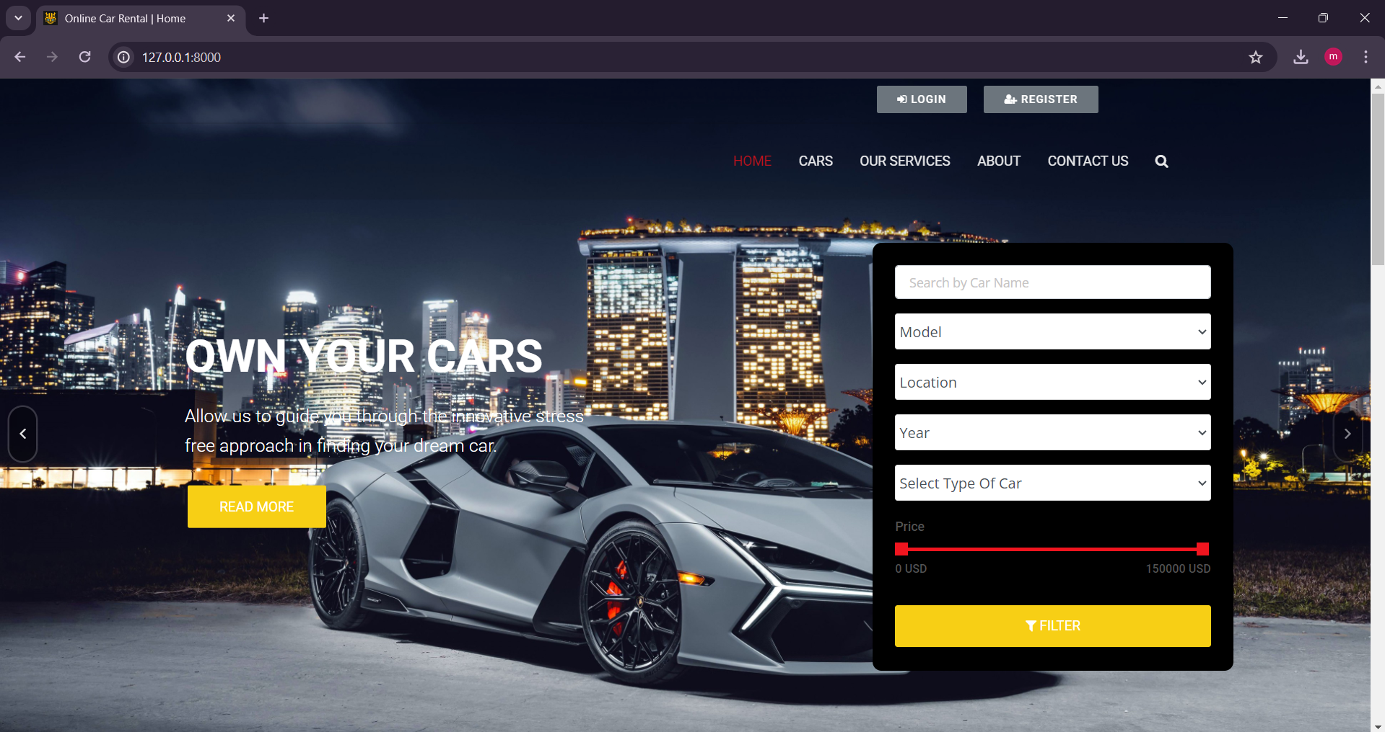
Homepage

Slide 10
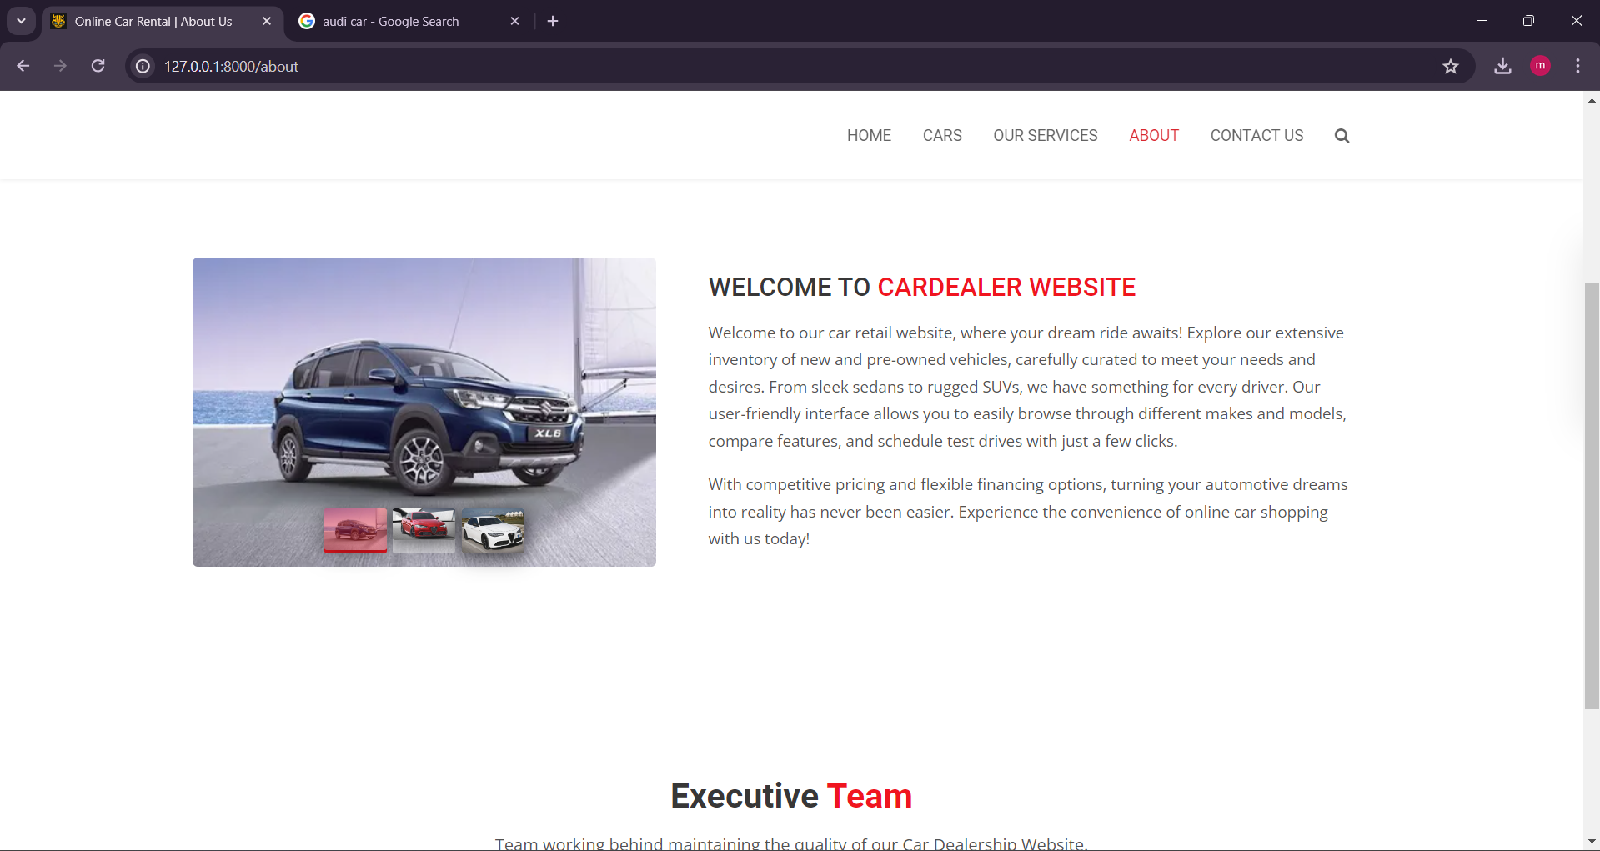
About-Us-Page

Slide 11
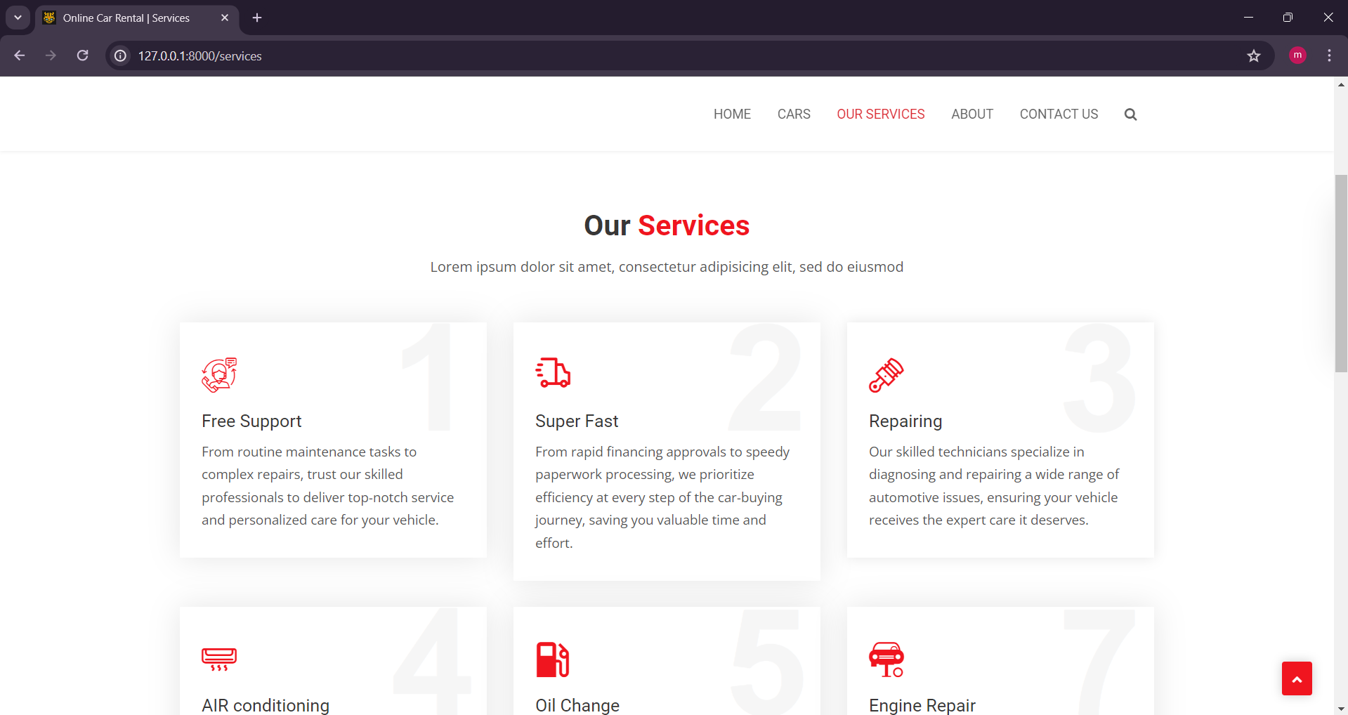
Service-Page

Slide 12
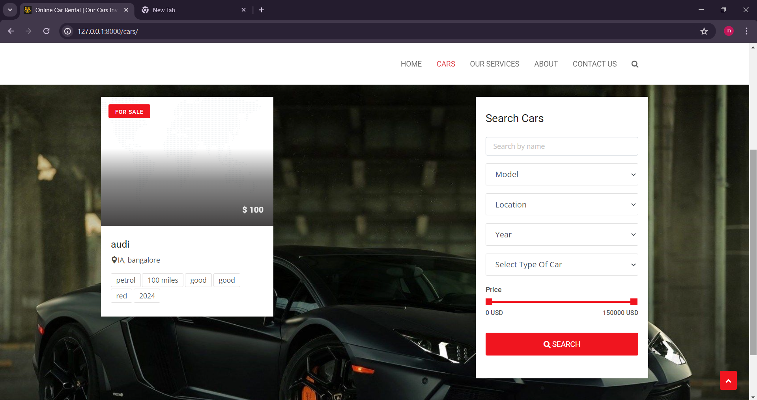
Departments-Page

Slide 13
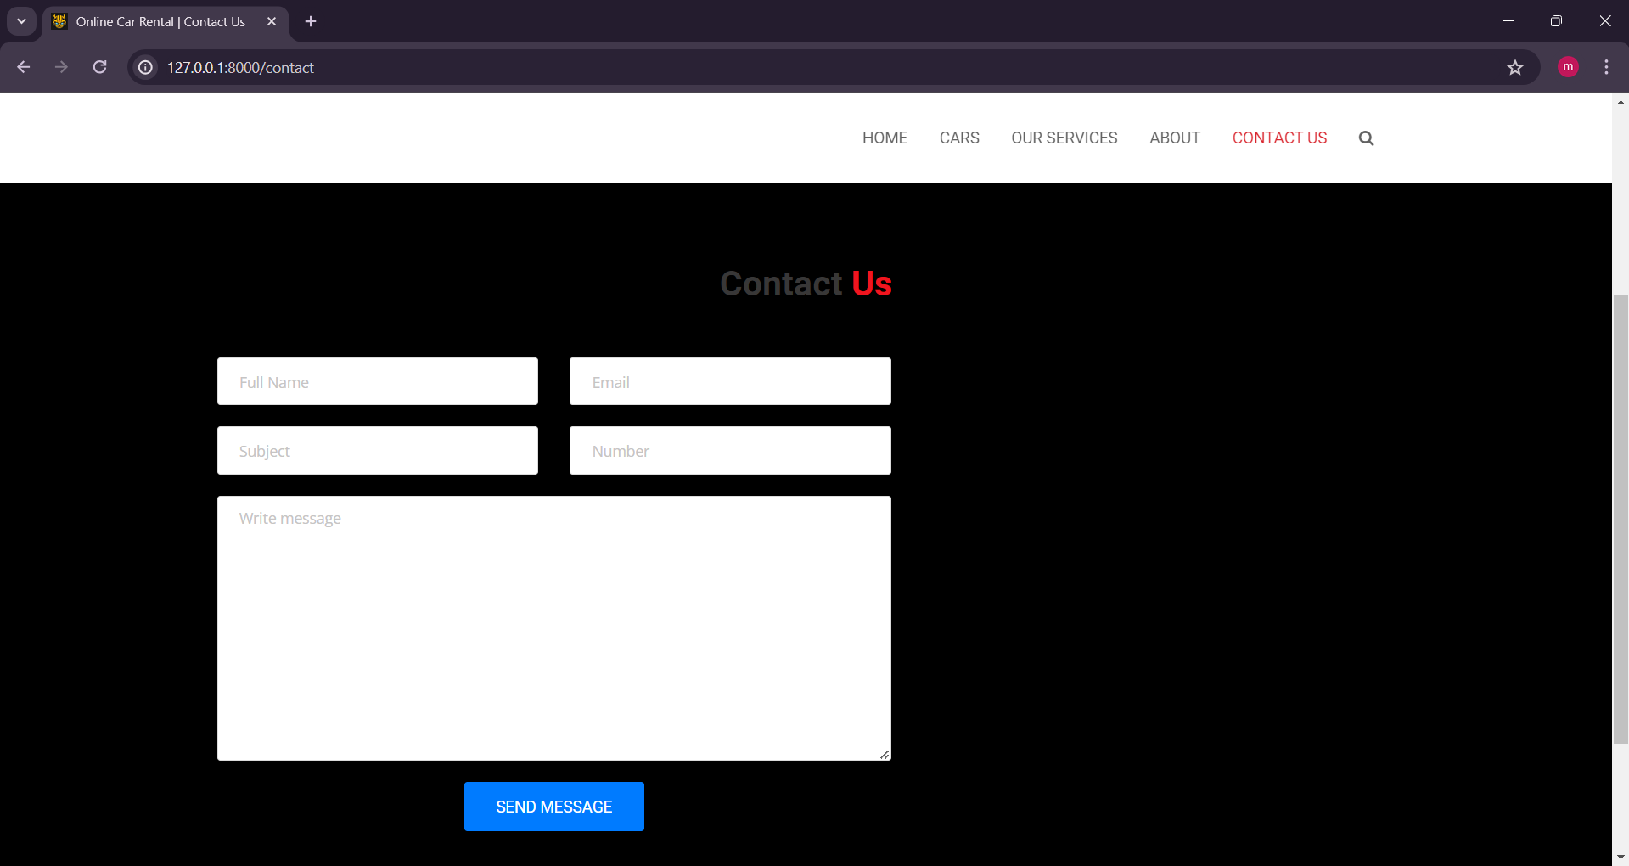
Blog-Page

Slide 14
Future Enhancements:
Incorporating a loyalty rewards program that incentivizes repeat bookings and referrals.
Users could earn points for each rental, which can be redeemed for discounts on future rentals, complimentary upgrades, or exclusive perks such as priority booking status.
By fostering customer loyalty and incentivizing engagement, this feature not only enhances user satisfaction but also drives repeat business and word-of-mouth referrals, ultimately contributing to the growth and success of the car rental platform.

Slide 15
Conclusion
In summary, a car rental application serves as a pivotal tool in meeting the evolving needs of modern-day mobility.
Through its user-friendly interface, extensive vehicle selection, and transparent pricing, the platform offers unparalleled convenience and flexibility to both renters and car owners alike.
Moreover, the integration of advanced features such as GPS navigation, digital contracts, and vehicle tracking not only streamlines the rental process but also enhances customer satisfaction and loyalty.
As the demand for mobility solutions continues to rise, investing in technology-driven car rental platforms represents a strategic opportunity for growth and innovation within the transportation industry.
By embracing these advancements and prioritizing user experience, car rental applications can position themselves as leaders in the market, driving forward progress and shaping the future of urban mobility.

Slide 16
Thank You!
Notes:
Thank You !!

